Slide 1


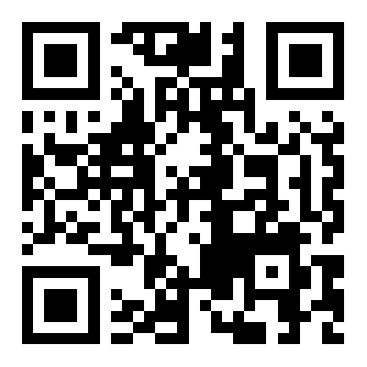
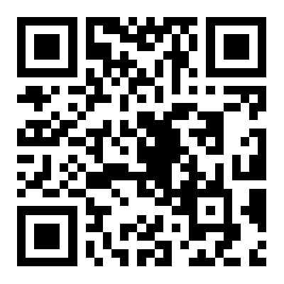


Off-Centered WoS-Type Solvers with Statistical Weighting
Anchang Bao Tsinghua University
Jie Xu University of Electronic Science and Technology of China
Enya Shen Tsinghua University, Haihe Lab of ITAI
Jianmin Wang Tsinghua University
Code
Paper
Notes:
Good afternoon everyone. (pause 1s)
Today I’m excited to present our work Off-Centered W-O-S–Type Solvers with Statistical Weighting.
This project focuses on improving the robustness and accuracy of Monte Carlo P-D-E solvers— especially the Walk-on-Spheres, or W-O-S, family

Slide 2
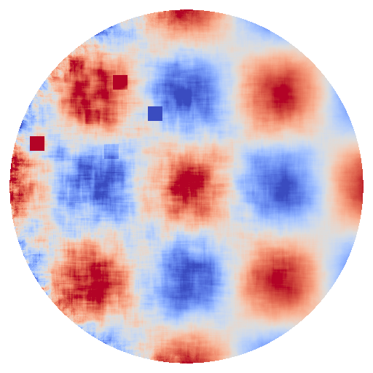
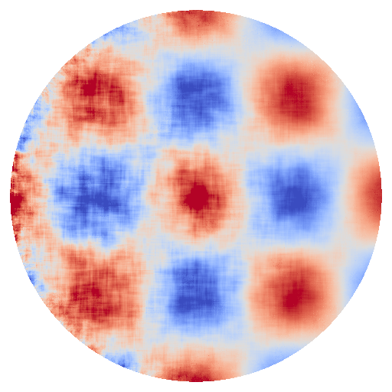
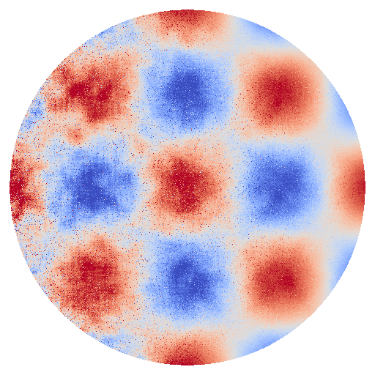
Scope
Goal: Reduce variance of WoS solvers without introducing correlation artifacts.
Uniform Weighting
Statistical Weighting
Notes:
— by enabling safer and more effective reuse of samples between evaluation points (...)
without correlation artifacts and reducing additional bias. (slow down on “without...bias”)

Slide 3
Introduction and Challenges

Slide 4
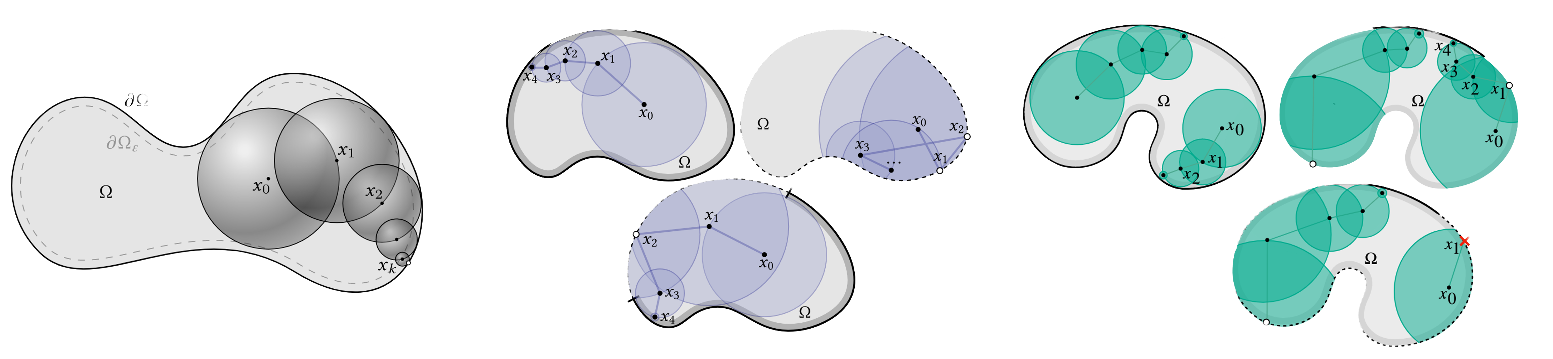
WoS-Type solvers develop rapidly
WoS-type Monte Carlo PDE Solvers are attractive in computer graphics due to their impressive flexibility.
Dirichlet boundary
Neumann boundary
Robin boundary
Sawhney and Crane 2020
Sawhney et al. 2023
Miller et al. 2024
Different boundary conditions
Notes:
Walk-on-Spheres solvers are increasingly popular because they do not require meshing and can handle extremely complex geometry. (emphasize “very complex geometry”)
Over the last few years, W-O-S–type methods have advanced rapidly. We’ve seen works extending them to different boundary conditions. (steady pace)

Slide 5
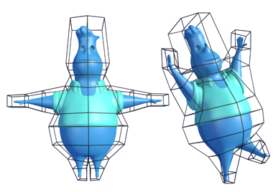
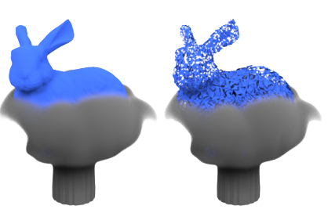
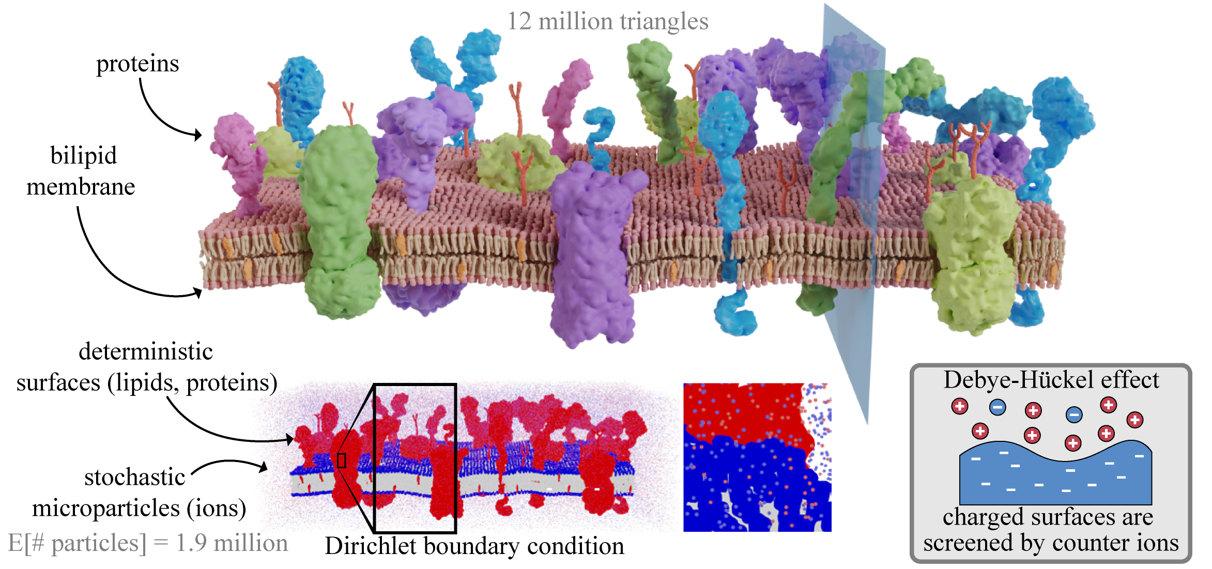
WoS-Type solvers develop rapidly
WoS-type Monte Carlo PDE Solvers are attractive in computer graphics due to their impressive flexibility.
Shape deformation
Fluid simulation
Participating media
de Goes and Desbrun 2024
Rioux-Lavoie et al. 2022
Miller et al. 2025
A variety of applications in computer graphics
Notes:
And a wide range of applications, including:
shape deformation,
fluid simulation,
and participating media exploration. (slight pause after each bullet)
Their geometric flexibility is really one of their biggest advantages. (slow slightly)

Slide 6
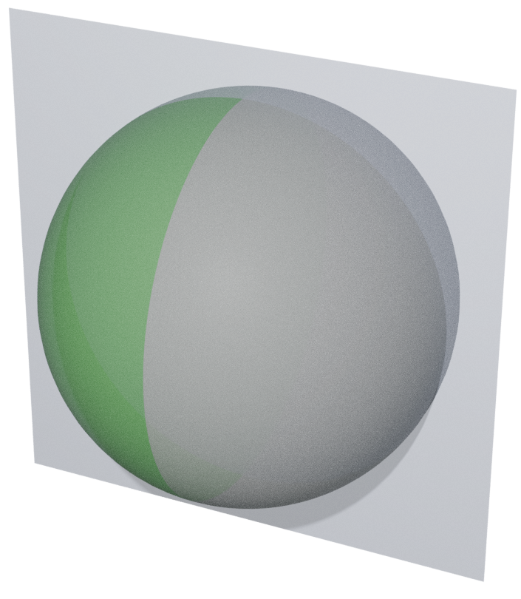
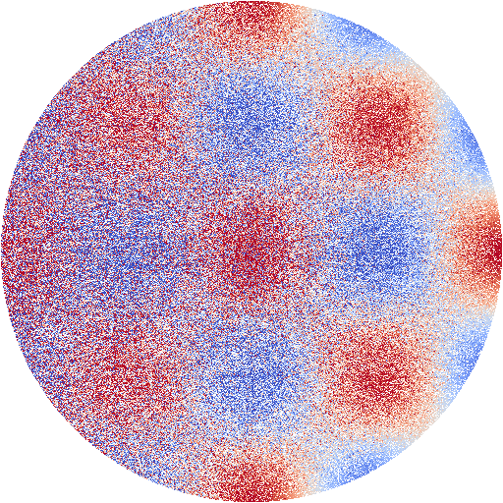
Noise and variance reduction
However, WoS-type solvers still suffer from noise due to Monte Carlo Integration
Noisy Result
Slice of evaluation points
Setup:
WoSt Solver
Neumann boundary
Dirichlet boundary
Notes:
But like any Monte Carlo method, W-O-S suffers from high variance. Here you see a typical noisy W-O-S output. (pause 1s)
To make these solvers practical, we need effective ways to reuse samples. But naïve reuse introduces correlation between evaluation points, leading to structured noise and visible artifacts in the solution field. (emphasize “structured noise” and “visible artifacts”)

Slide 7
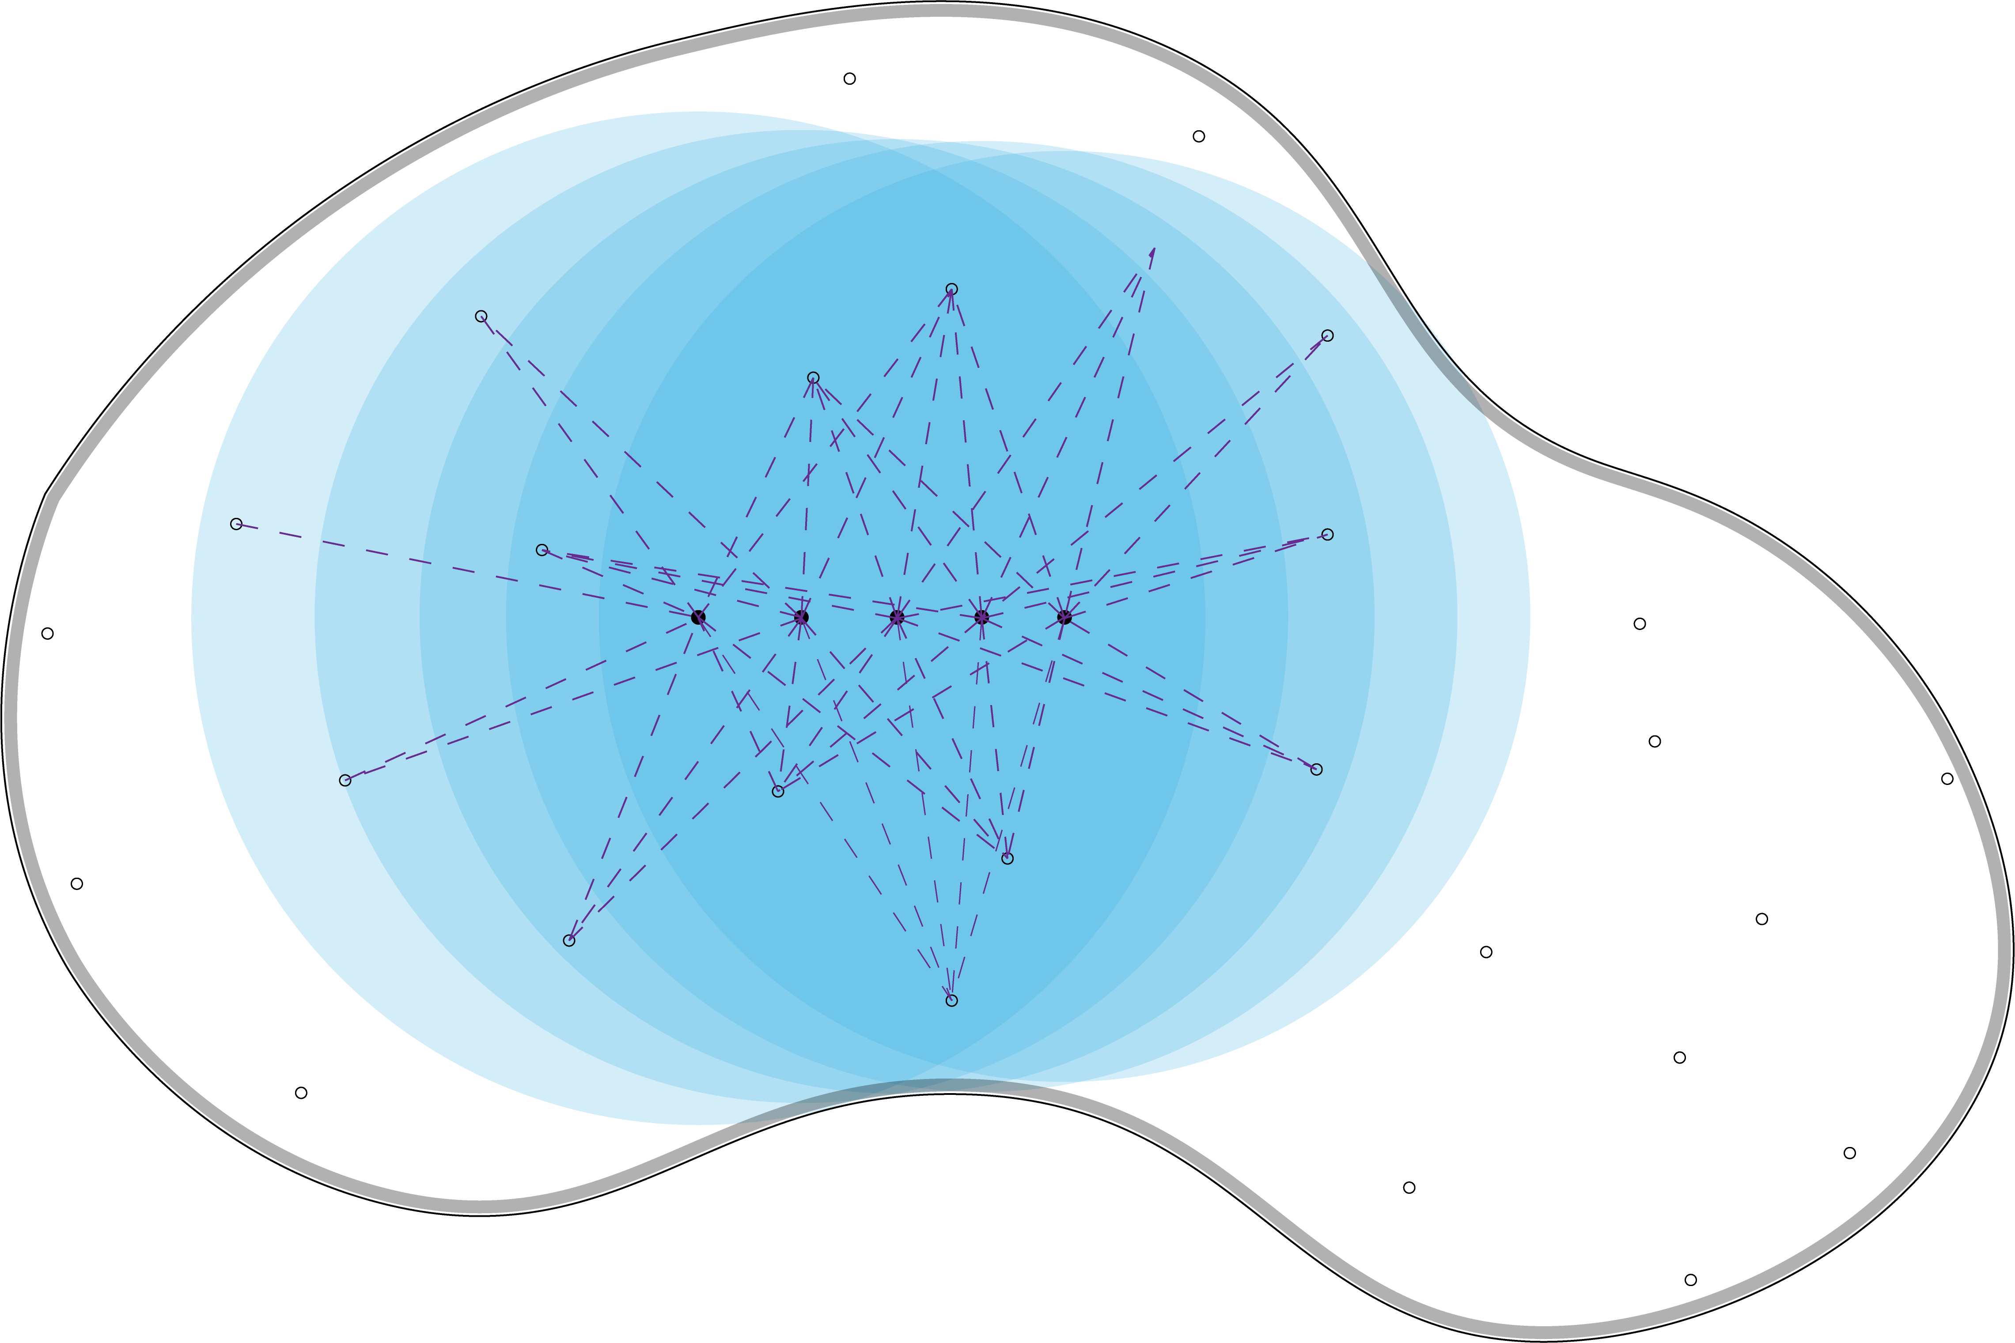
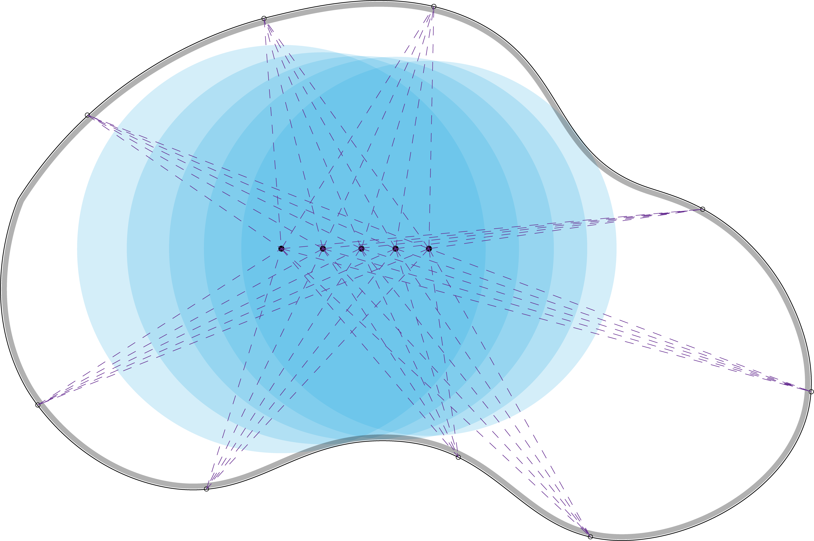

Noise and variance reduction
Recently, some methods reduce variance via introducing correlation
Mean Value Caching
Boundary Value Caching
Off-Centered Reuse
[1] Bakbouk et al Peers. 2023. Mean Value Caching for Walk on Spheres. In Eurographics Symposium on Rendering
[2] Miller et al. 2023. Boundary Value Caching for Walk on Spheres. ACM Transactions on Graphics.
[3] Czekanski et. al. 2024. Walking on Spheres and Talking to Neighbors: Variance Reduction for Laplace's Equation. Arxiv
Notes:
Several recent works reduce variance by introducing correlation between evaluation points:
Mean Value Caching,
Boundary Value Caching,
and a recent off-centered reuse, Czekanski et al. 2024 (Czekanski = “chek-AHN-skee”).
In our work, we follow this off-centered strategy. (pause 0.5s)

Slide 8
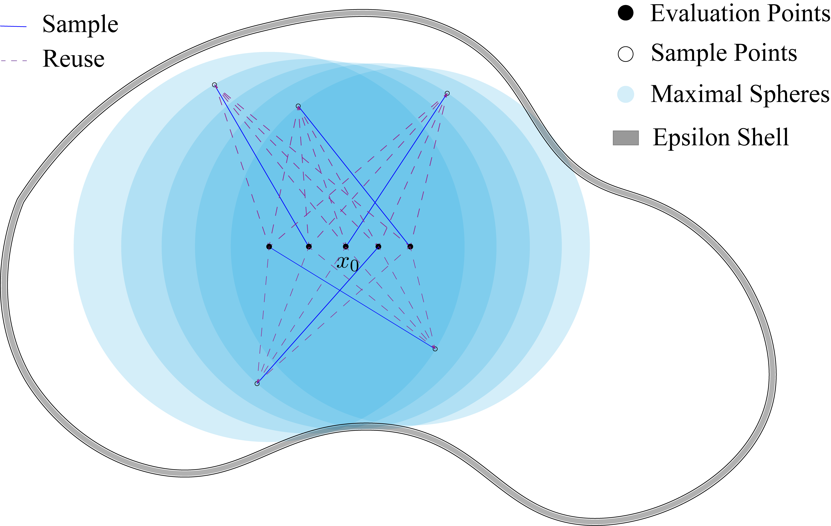
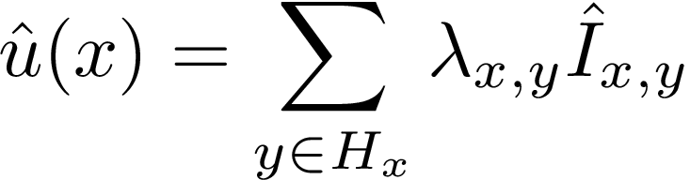
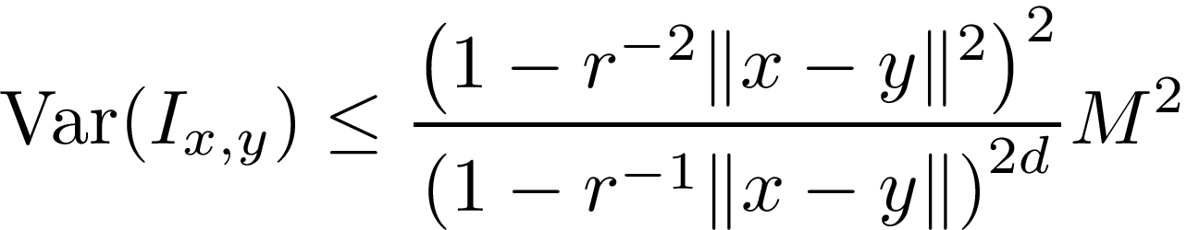
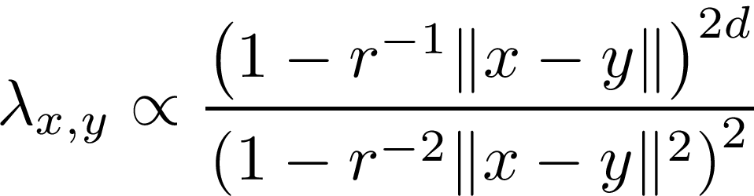
Previous approach
Estimator: reuse samples from neighbors
Variance reduction: via a deterministic bound
Off-Centered Reuse Scheme
Only for the Laplace equation
Notes:
Their idea is intuitive:
“If two points are close, why not share samples?” (say with a light tone)
For each point x, they reuse estimators from other spheres that also cover x This provides more information and reduces variance.
They proved that the optimal weight is inversely proportional to variance, and use a variance bound derived from the Poisson kernel, which only hold for Laplace equation, to combine these estimators.
This works well for the Laplace case. But when we try to generalize it, we encounter two key issues. (slow down)

Slide 9
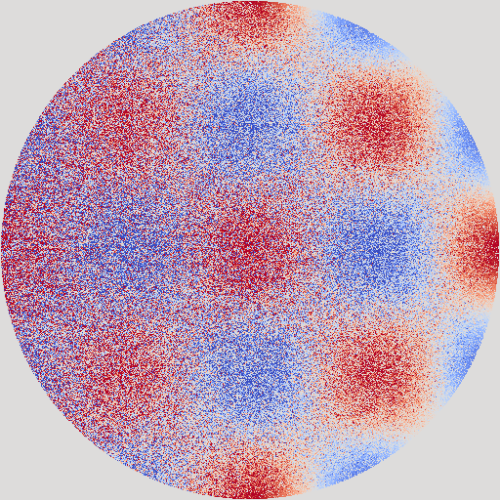
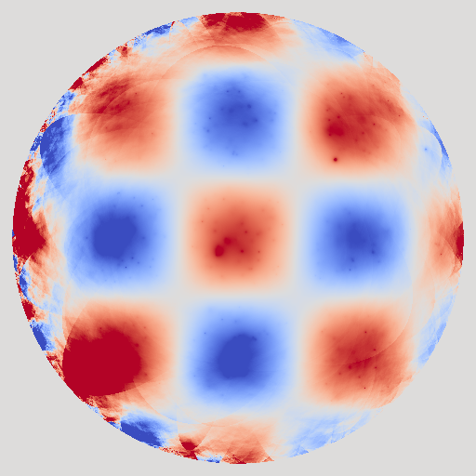
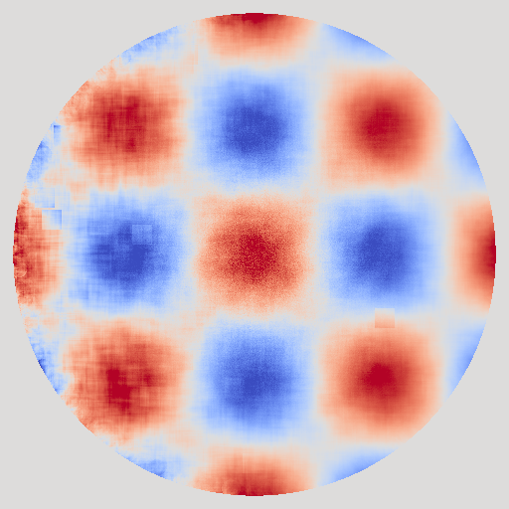
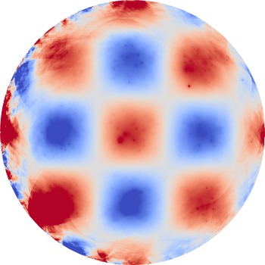
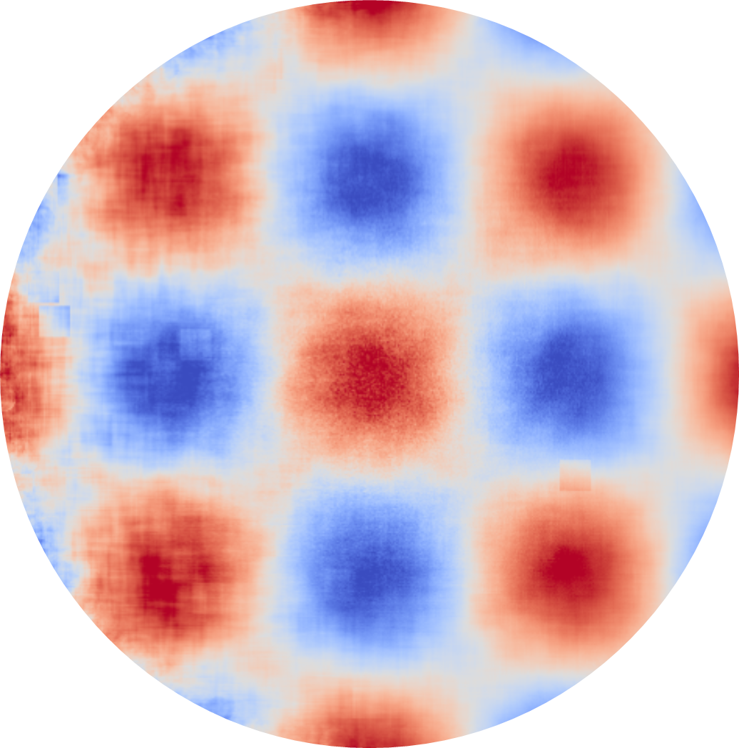
Issue1: Correlation creates artifacts
Vanilla WoS
Mean Value Caching
Off-Centered Reuse
Correlated
Zoom In
Poisson-bound weights are deterministic. Outliers can not be recognized.
Notes:
The first issue is correlation artifacts.
When samples are reused deterministically, nearby points become correlated. This produces structured noise patterns—grid-like or streaky artifacts— which may mislead users about the true behavior of the underlying equation and physics. (slightly slower here)
Poisson-bound weighting cannot detect outliers, because the weights are completely deterministic. So even a very wrong estimate from one neighbor affects the final result remarkably.

Slide 10
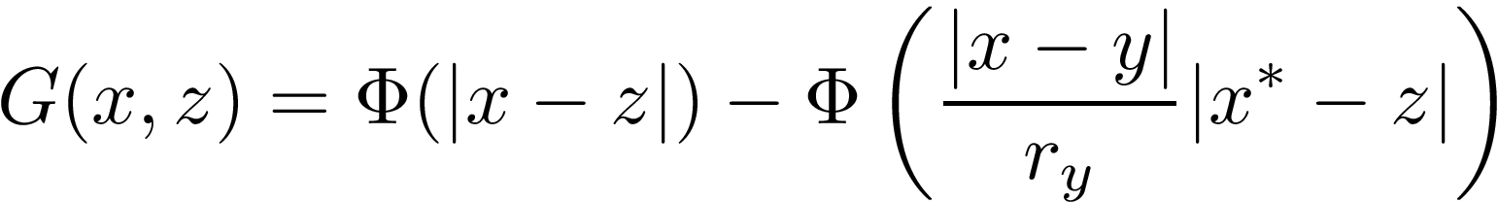
Issue2: Off-Centered Green's Function
Green's function is not always in a simple closed form and may need approximation.
Poisson
Easy to compute but ignored by Poisson Bound Weighting
Screened Poisson
Need Approximation
Notes:
The second issue comes from the off-centered Green’s function.
The variance bound used by Czekanski et al. only holds for the Laplace equation. For Poisson, this bound no longer holds.
And for Screened Poisson, the off-centered Green’s function is not analytically available, so we must approximate it. (slow down on “not analytically available”)
This breaks the assumptions of Poisson-bound weighting and may introduce additional bias. (pause 0.5s)

Slide 11
Statistical Weighting

Slide 12
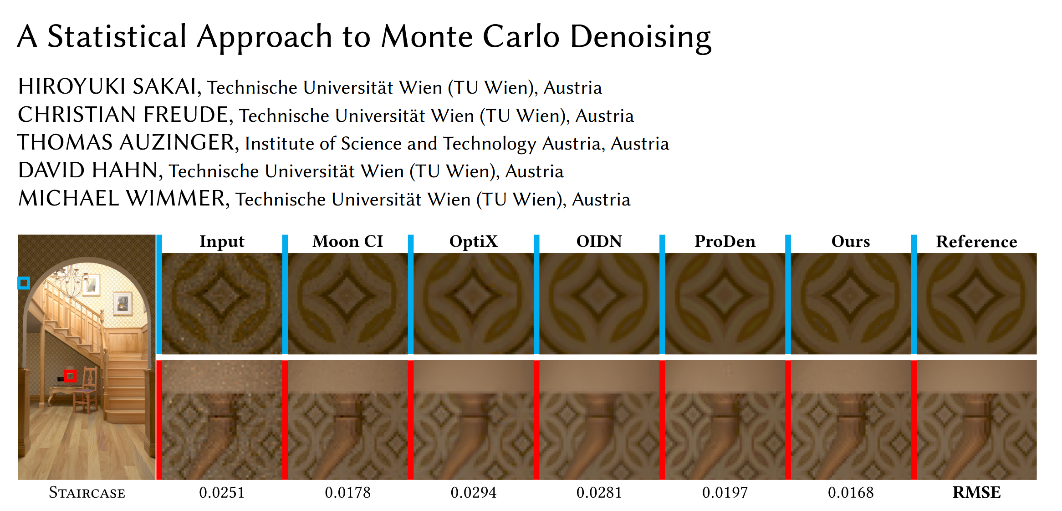
Motivations
Recently, rendering community introduced a statistical approach for Monte Carlo denoising
The key idea: if two adjacent pixels have similar estimation, reuse samples between them.
Notes:
To address these issues, we take inspiration from the rendering community.
Sakai et al. 2024 (Sakai = “sah-KAI”) introduced a statistical approach to reuse samples only when neighboring pixel estimates are statistically compatible.
This prevents reusing unreliable information and avoids correlation artifacts.
We adapt this idea to the W-O-S setting. (slightly upbeat tone)

Slide 13
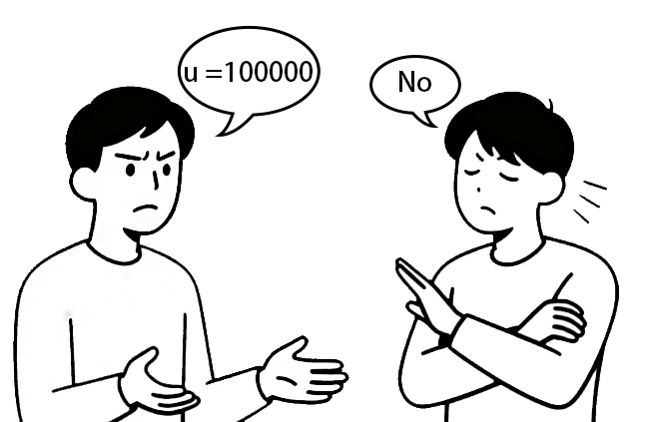
Off-Centered Reuse with Statistical Weighting
Overall, our algorithm have two stages
Stage1: Collecting data independently
Stage2: Off-Centered reuse with statistical weighting
Run standard solvers
Check if neighbor's data is reliable
Notes:
Our method is a two-stage algorithm.
Stage 1: centered estimator
Each point runs standard W-O-S on its own maximum ball. This stage is fully unbiased and independent.
Stage 2: off-centered reuse with statistical weighting
Then each point examines its neighbors.
For each neighbor we compute:
the sample mean,
the variance of sample mean,
and a statistical similarity test.
Only consistent estimators are included.
Core idea:
“Trust only neighbors whose data agrees with the centered estimator.”
(slow down slightly)

Slide 14
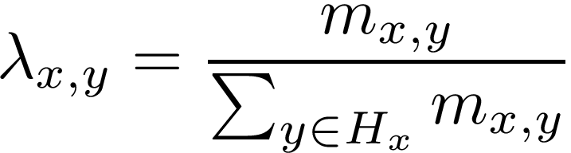
Off-Centered Reuse with Statistical Weighting
The solution $u\left(x\right)$ can be estimated by data from neighbor $y$. Denote as $I_{x, y}.$
Stage 1
(Representation formula)
Special case: $I_{x, x}$ is the centered estimator and same as the vanilla WoS(t) estimation.
Combine these estimators with weights $λ_{x,y}$ :
If $I_{x, y}$ passed the similarity test with centered estimator $I_{x, x}$, assign $m_{x, y}=1$, otherwise 0.
Stage 2
Notes:
The solution u(x) can be written as an integral over the boundary of any sphere covering x.
For each neighbor y, we have an estimator I_{x,y}.
Our goal is to choose weights λx,y to combine these estimators. In our framework, λ is the normalization of a binary mask m, where mx,y=1 if the similarity test passes, and 0 otherwise.
Keep only the trustworthy neighbors.

Slide 15
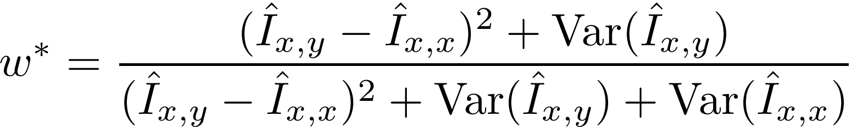
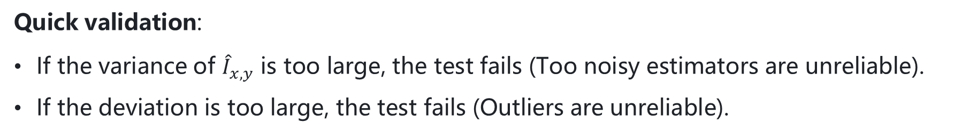
Off-Centered Reuse with Statistical Weighting
In detail, the similarity test between $I_{x, x}$ and $I_{x, y}$ needs the following statistic
update on-the-fly in stage 1
If $1−w^{∗}$ exceeds a predefined value, the estimator will pass the similarity test.
Quick validation:
If the variance of ${\hat{I}}_{x, y}$ is too large, the test fails (Too noisy estimators are unreliable).
If the deviation is too large, the test fails (Outliers are unreliable).
Notes:
The similarity test works as follows:
we collect samples from each sphere and obtain:
a running sample mean,
and a running variance.
In Stage 2, we compare each off-centered estimator with the centered estimator, using this statistic.
For a quick check.
If the variance is too large or the value deviates too much, we reject that neighbor. (gesture “reject”)
This ensures:
outliers are ignored
correlation does not propagate errors
only statistically compatible neighbors contribute to the final result

Slide 16
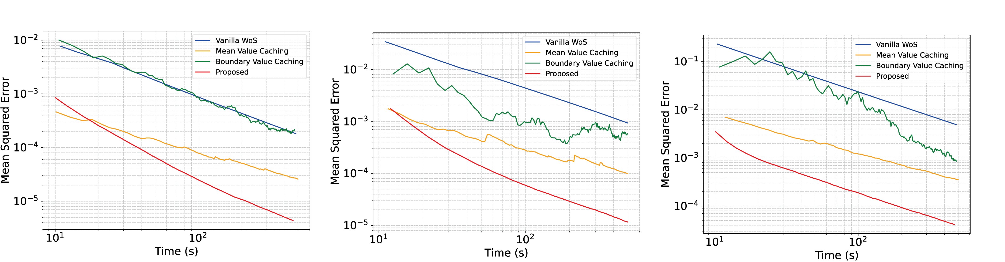
Off-Centered Reuse with Statistical Weighting
Convergence: For Poisson, proposed estimator is biased, but still converge to the solution
A short error analysis
Converge to zero
Notes:
Our estimator is biased, because filtering introduces correlation. (slow and clear)
But! We show both analytically and empirically that:
convergence is preserved for Laplace. As the number of samples increases, the result converge to the correct solution

Slide 17
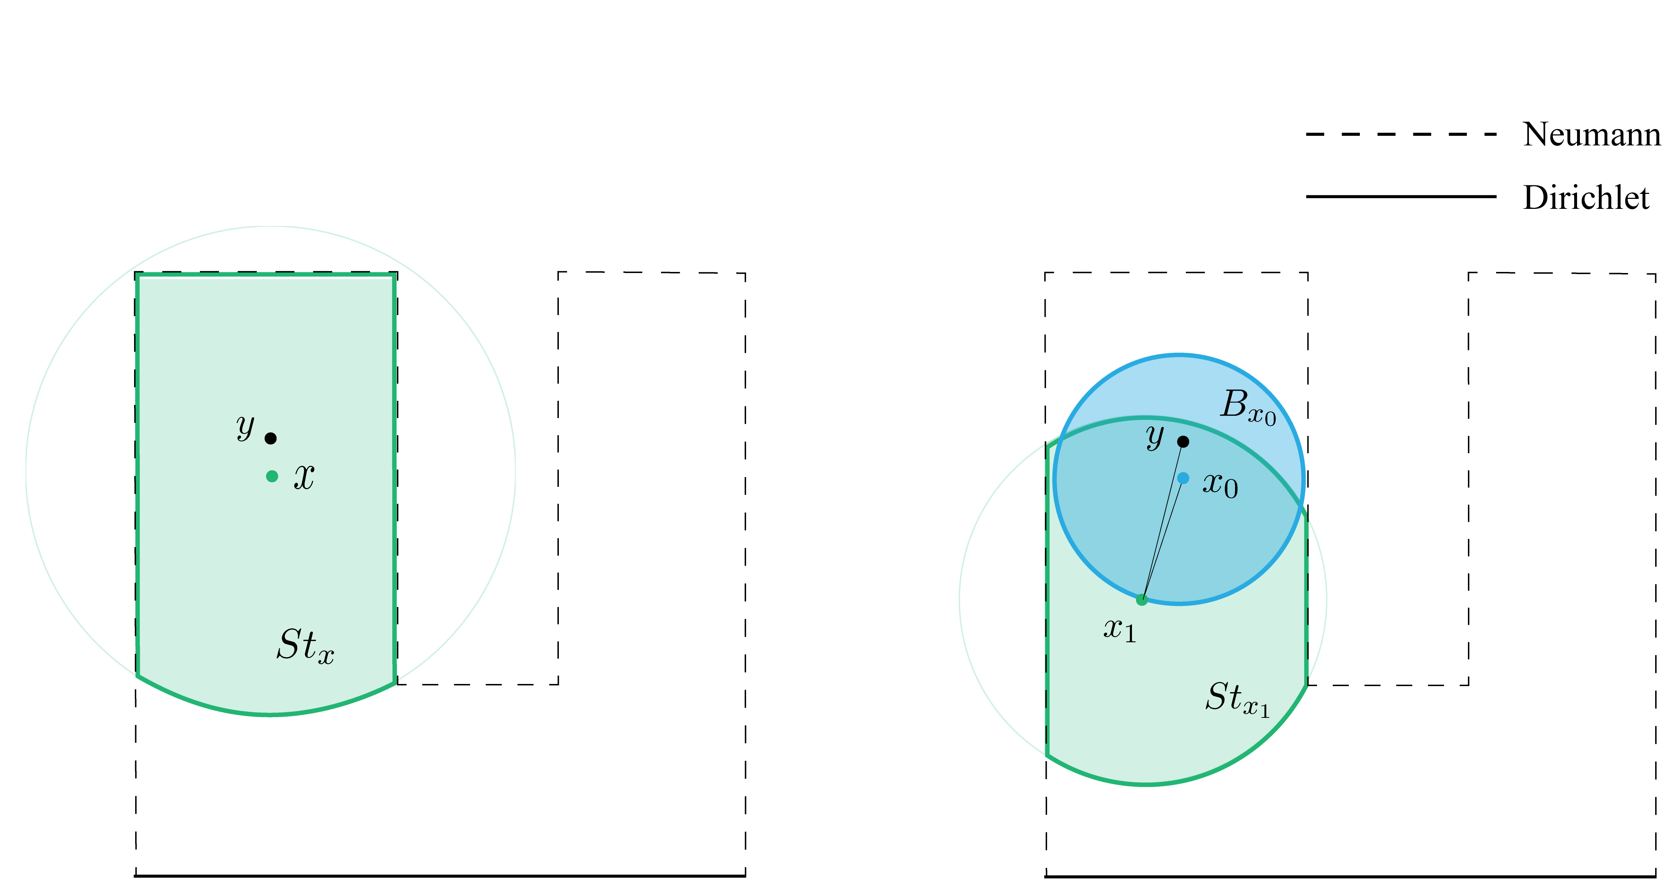
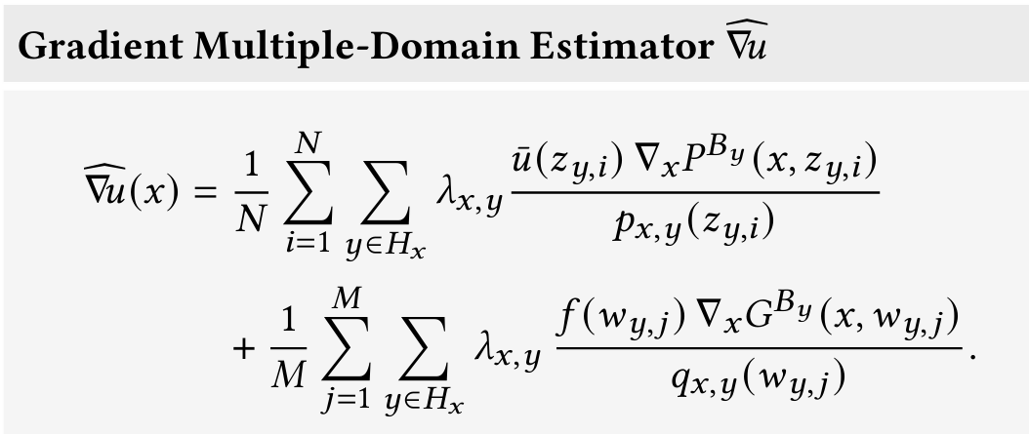
Mixed Boundary and Gradient Estimation
Proposed strategy also applies to mixed boundary value problems and gradient estimation
Mixed boundary conditions
Gradient estimation formulation
Notes:
We also extend our method to:
mixed boundary conditions
gradient estimation
Both are challenging because variance is higher, and outliers are more common. (slower)

Slide 18
Results

Slide 19
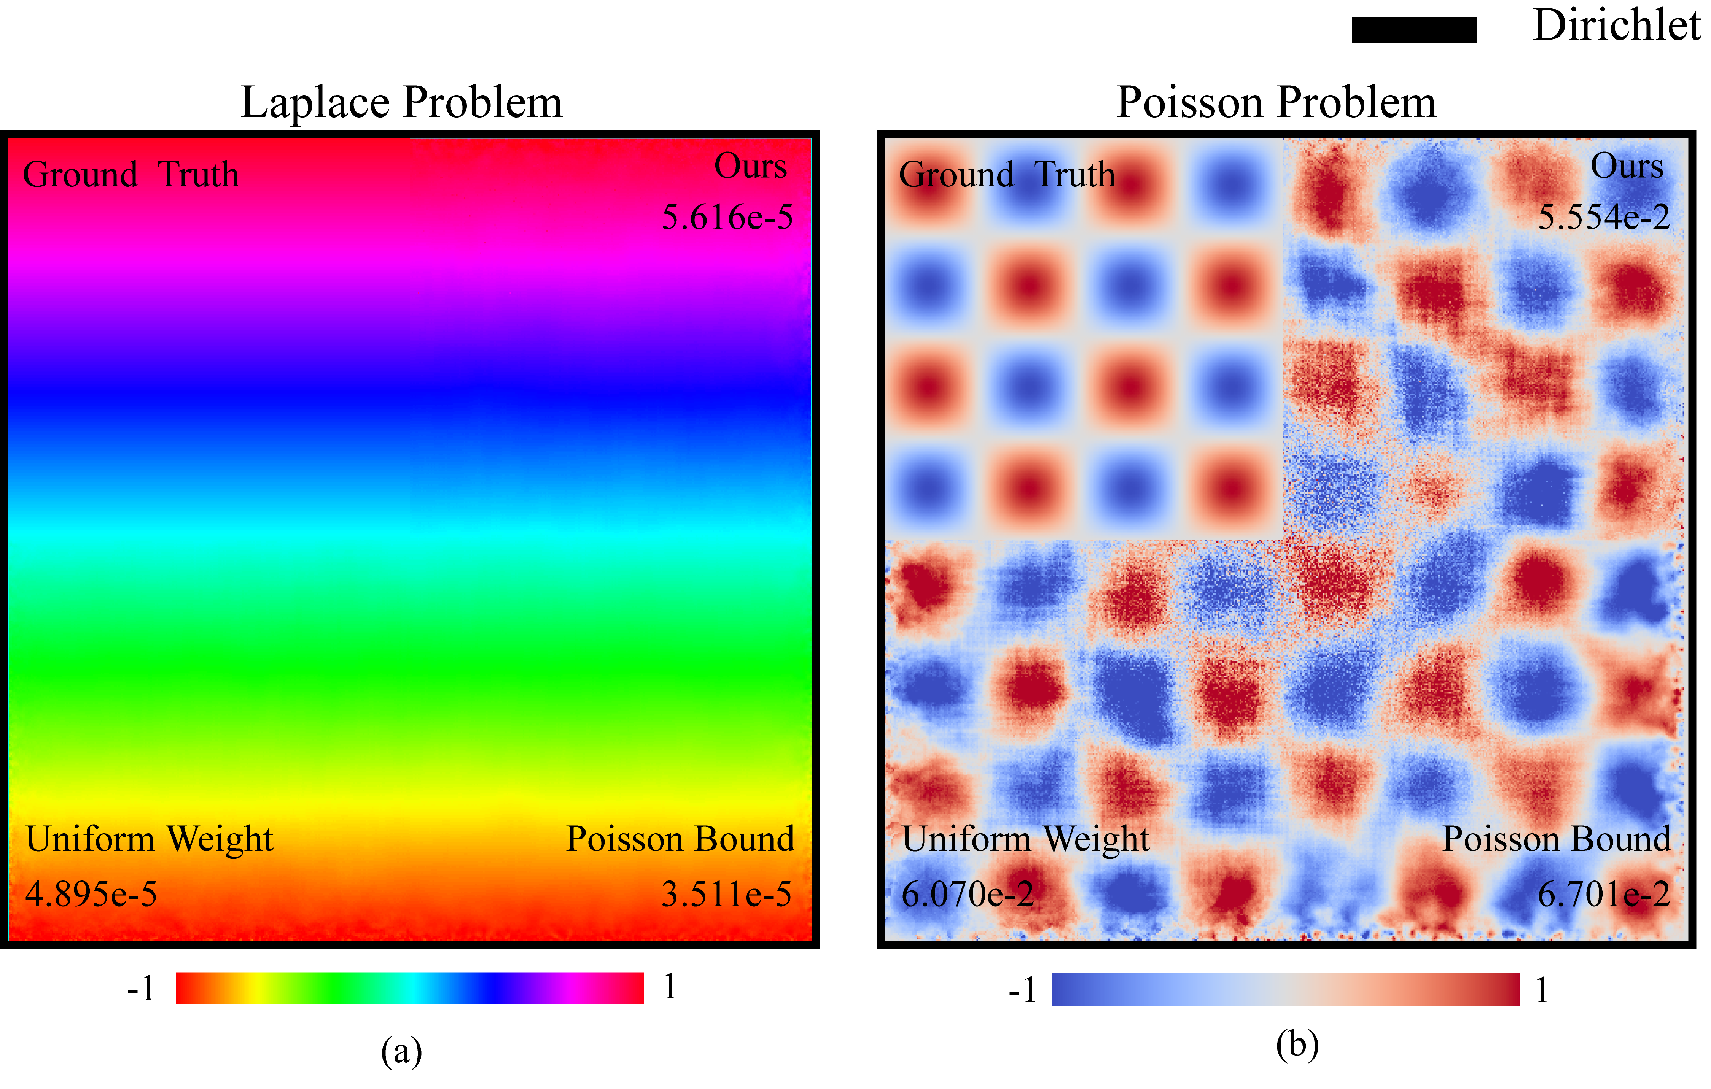
Results: Laplace Equations
We reproduced the simple Laplace equation example
in the paper of Czekanski et al. [2024].
Compared with uniform weighting and Poisson-bound weighting, the proposed algorithm performs weakly.
Notes:
For Laplace, Poisson-bound weighting is still strong and our method is slightly weaker here — as expected.

Slide 20
Results: Laplace Equations
We reproduced the simple Laplace equation example
in the paper of Czekanski et al. [2024].
Compared with uniform weighting and Poisson-bound weighting, the proposed algorithm performs weakly.
But for the Poisson equation, the motivation of the Poisson-bound no longer holds due to the more complex formulation. Our method generated better results.
Notes:
Once a source term is introduced, Poisson-bound weighting breaks down.

Slide 21
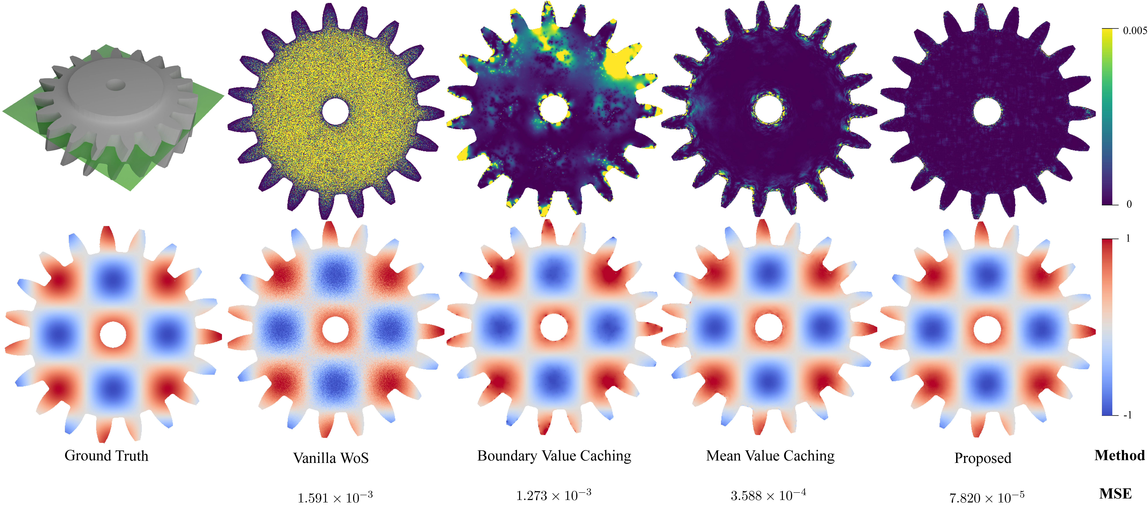
Results: Poisson Equation
First row: Geometry and error map Second row: Final results
Notes:
Also, our method performs better than other previous variance reduction methods.
Here we present a comparison between previous variance reduction methods and the proposed approach. Error map and MSE values prove the improvement.
(moderate speed)

Slide 22
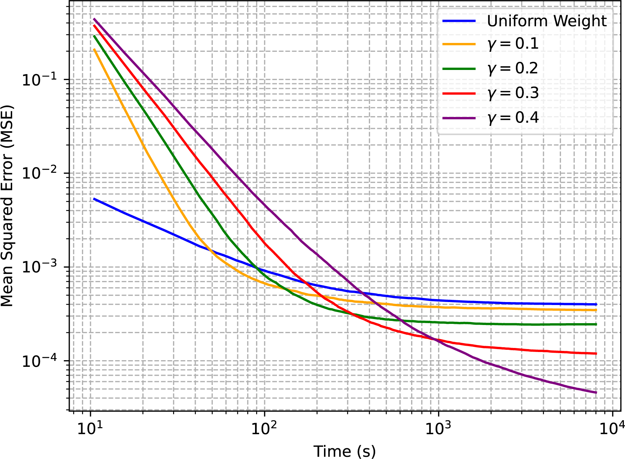
Results: Screened Poisson Equation
For screened Poisson equations, we reach remarkable improvement than the simple weighting strategy
We can tune the hyperparameter to make a bias-variance trade-off.
Notes:
Screened Poisson amplifies variance further and the approximated Green's function brings systematic bias. Our statistical weighting significantly reduces artifacts and offers a clear bias–variance trade-off via a single hyperparameter. Converges curves and error maps prove that.

Slide 23
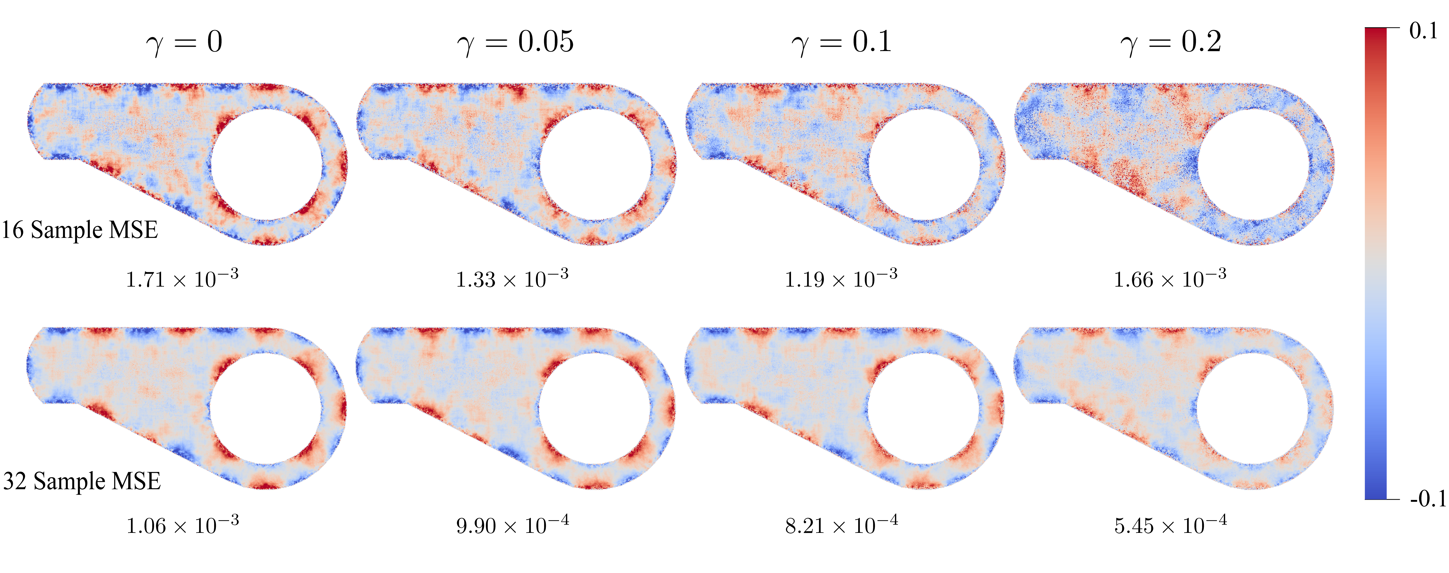
Results: Screened Poisson Equation
For screened Poisson equations, we reach remarkable improvement than the simple weighting strategy
We can tune the hyperparameter to make a bias-variance trade-off.

Slide 24
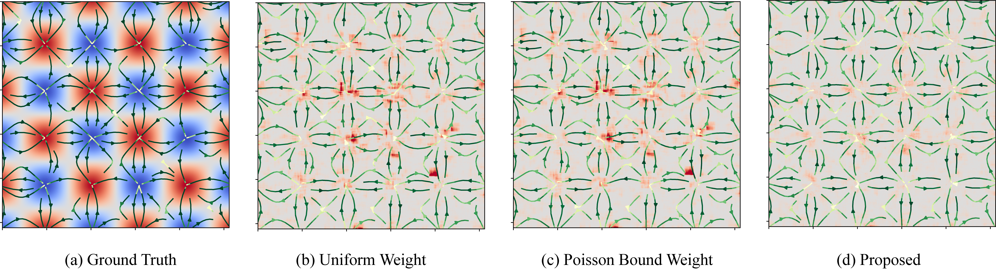
Results: Gradient Estimation Tasks
Gradient estimation tasks commonly have larger variances, our method significantly reduced variance and identified outliers to avoid correlation artifacts.
Notes:
Gradient estimation empirically has very higher variance.
The figure presents result on gradients estimation and the background heat map is the squared error. Our method reduces propagation of outliers and hence avoids correlation artifacts. (slow to emphasize impact)

Slide 25
Summary
We proposed an off-centered local sample reuse scheme for WoS-type solvers.
For each evaluation point, reuse data from its neighbors
When reusing samples, use statistical weighting to reject unreliable data
The proposed method can be applied to a variety of problems
Equations: Laplacian, Poisson, and screened Poisson
Boundary: Support mixed boundary conditions
Tasks: solution estimation and gradient estimation
Limitations and future work
For the Laplace case, the result does not keep the mean value property
Advanced denoising techniques
Integrate with other variance reduction approaches
Notes:
To summarize:
We introduce a statistical weighting scheme for off-centered reuse in W-O-S–type solvers.
It selectively rejects unreliable neighbors.
It supports Laplace, Poisson, screened Poisson, and mixed boundary problems.
It applies to both solution and gradient estimation.
And it mitigates correlation artifacts while enabling robust sample reuse.
(slow, with clarity)

Slide 26
Thanks
Code
Paper
Notes:
Thank you for listening. (pause 1s)
I’d be happy to answer any questions.

